Slide 1
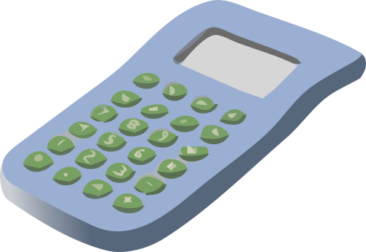
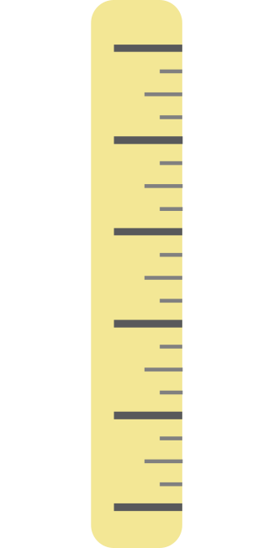
Anagrams
What do I need to bring to every maths lesson?
ENP
NICELP
OKBO
URREL
BURREB
LALACROCUT
CARROTPORT
SCAMPSO
ARGET FORFET
SHINEATSUM
PEN
PENCIL
BOOK
RULER
RUBBER
CALCULATOR
PROTRACTOR
COMPASS
GREAT EFFORT
ENTHUSIASM

Slide 2
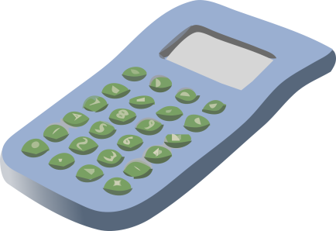
Calculator race
Use your calculator to answer these sums.
Speed and accuracy are both needed…
1 + 2 + 3 + 4 + 5 + 6 + 7 + 8 + 9 + 10
1 x 2 x 3 x 4 x 5 x 6 x 7 x 8 x 9 x 10
1000 + 100 + 10 + 1 + 0.1 + 0.01 + 0.001
1000 – 100 – 10 – 1 – 0.1 – 0.01 – 0.001
1000 x 100 x 10 x 1 x 0.1 x 0.01 x 0.001
(1 + 2) x (3 + 4) x (5 + 6)
1 + (2 x 3) + (4 x 5) + 6
55
3,628,800
1111.111
888.889
1
231
33

Slide 3
All’s square
Use the squaring button on your calculator to find the value of these square numbers:
$$x^{2}$$
a) 1² = b) 2² = c) 3² =
d) 4² = e) 5² = f) 6² =
g) 7² = h) 8² = i) 9² =
j) 10² = k) 11² = l) 12² =
m) 13² = n) 14² = o) 15² =
p) 20² = q) 100² = r) 1000² =
s) 2.5² = t) 0.7² = u) ½² =
1
16
49
100
169
400
6.25
4
25
64
121
196
10,000
0.49
9
36
81
144
225
1,000,000
¼

Slide 4
Square roots
Every maths function has an opposite,
or an inverse.
Examples: + and -, x and ÷
What is the inverse of squaring a number?
Finding the square root, using this button on your calculator:
√
Check! 6² = 36 ⇔ √36 = 6

Slide 5
Square roots
Find these square roots:
√1 = b) √25 = c) √100 =
d) √144 = e) √196 = f) √900 =
g) √559504 = h) √0.64 = i) √¼ =
1
5
10
12
14
30
748
⁴/₅
= 0.8
½
= 0.5
Do all numbers have ‘nice’ square roots? Investigate…

Slide 6
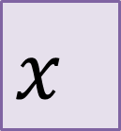
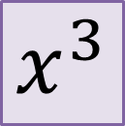
Calculator $x$-Boxes
You might have a cubing button
on your calculator,
or you might have to use the power/index button with a ‘3’.
$$x^{3}$$
$$x^{}$$
Find the value of these cube numbers:
a) 1³ = b) 2³ = c) 3³ =
d) 4³ = e) 5³ = f) 6³ =
g) 7³ = h) 8³ = i) 9³ =
j) 10³ = k) 100³ = l) 2.5³ =
m) 0.1³ = n) 2.3³ = o) ½³ =
p) ¼³ = q) 42³ = r) (-5)³ =
1
64
343
1000
¹/₁₀₀₀
¹/₆₄
8
125
512
1000000
12.167
74088
27
216
729
15.625
¹/₈
-125

Slide 7



Let’s get some fraction action…
This is the fraction button
on your calculator:
Find the answer to these fraction calculations:
$\frac{1}{2}+\frac{1}{5}=$
$\frac{3}{4}−\frac{2}{5}=$
$\frac{1}{4}×\frac{9}{10}=$
$\frac{1}{6}÷\frac{2}{3}=$
${(\frac{4}{5})}^{2}=$
${(\frac{3}{10})}^{3}=$
$3\frac{2}{5}+2\frac{1}{4}=$
$1\frac{7}{10}×4\frac{1}{5}=$
$$\frac{7}{10}$$
= 0.7
= 0.35
= 0.225
= 0.25
= 0.64
= 0.027
Use the fraction ⟷ decimal conversion button to write the answers as decimals as well as fractions
$$\frac{7}{20}$$
$$\frac{9}{40}$$
$$\frac{1}{4}$$
S D
$$\frac{16}{25}$$
Press the shift button before the fraction button to write mixed whole numbers/fractions
$$\frac{27}{1000}$$
5$\frac{13}{20}$
= 5.65
7$\frac{7}{50}$
= 7.14

Slide 8


Calculator race
Use your calculator to answer these sums.
Speed and accuracy are both needed…
0.1 + 2.3 + 4.5 + 6.7 + 8.9
0.1 x 2.3 x 4.5 x 6.7 x 8.9
$\frac{1+2+3+4+5}{6+7+8+9+10}$
$\frac{1×2×3×4×5}{6×7×8×9×10}$
1 + $\frac{1}{2}$ + $\frac{1}{3}$ + $\frac{1}{4}$ + $\frac{1}{5}$
1 x $\frac{1}{2}$ x $\frac{1}{3}$ x $\frac{1}{4}$ x $\frac{1}{5}$
⁴⁵/₂ = 22.5
61.71705
³/₈ = 0.375
¹/₂₅₂ = 0.003968251
$\frac{137}{60}$
$\frac{1}{120}$

Slide 9
Calculator button wordsearch
Which buttons do you now know how to use on your calculator? Try and find them in the wordsearch:
B | N | O | F | F | D | D | A | T | M
F | R | A | C | T | I | O | N | T | U
T | D | A | X | S | V | K | E | Z | L
C | E | P | C | R | I | Z | E | A | T
A | L | T | O | K | D | C | M | Q | I
R | E | O | J | G | E | I | M | U | P
T | T | U | I | E | C | T | L | W | L
B | E | R | R | E | B | I | S | W | Y
U | L | M | D | L | L | U | O | N | H
S | Q | U | A | R | E | K | C | I | L
add
on
subtract
off
multiply
delete
divide
brackets
square
fraction
cube
decimal
root

Slide 10
Calculator button wordsearch
Which buttons do you now know how to use on your calculator? Try and find them in the wordsearch:
B |  | O | F | F | D | D | A |  | M
F | R | A | C | T | I | O | N |  | U
T | D | A |  |  | V |  |  |  | L
C | E |  | C | R | I |  |  | A | T
A | L |  | O | K | D |  | M |  | I
R | E | O |  |  | E | I |  |  | P
T | T |  |  | E | C | T |  |  | L
B | E |  |  | E | B |  | S |  | Y
U |  |  | D |  |  | U | O | N
S | Q | U | A | R | E |  | C
add
on
subtract
off
multiply
delete
divide
brackets
square
fraction
cube
decimal
root

Slide 11
Calculator confusion
BIDMAS
Brackets
Indices
Division
Multiplication
Addition
Subtraction
1 + 2 x 3 = 9. Right?
Check on your calculator. Wrong!
Which answer is biggest in each of these pairs of calculations? Can you explain why?
17x11+38 17x(11+38)
405-84÷6 (405-84)÷6
79+26x34 (79+26)x34
2.2x18² (2.2x18)²
(38+217)÷15 38+217÷15
26x41+122 (26x41)+122
√(14.44x0.25) (√14.44)x0.25
225
391
963
712.8
17
1188
1.9
782
53.5
3570
1568.16
52.46…
1188
0.95

